Slide 1

Construction Career Connections through Contractor/Classroom Collaboration

Slide 2
About OCA
Ohio’s trade association for the heavy highway construction industry
Established in 1918
Currently about 200 active (contractor) members and 300 associate members
Governed by a Board of Directors
9 Chapters around the state

Slide 3
Industry Workforce Need
AGC of America 2018 Workforce Survey Results Ohio
In the next 12 months 60% of contractors surveyed will hire salaried field personnel and 90% will hire hourly craft people
92% are having a hard time filling all or some positions
50 % of contractors surveyed increased base pay rates for hourly craft personnel and 40% increased for salaried personnel
Ohio predicts that by 2024 we will need to fill 23,820 positions in the industry. This includes all segments of the construction.

Slide 4
Connecting Students to Careers
Constructor for a Day Program
Provide students introductions to various trades and training program options
Provides students introductions to local contractors attending the event
Hands on experience visiting construction sites
Breakfast and Lunch!

Slide 5
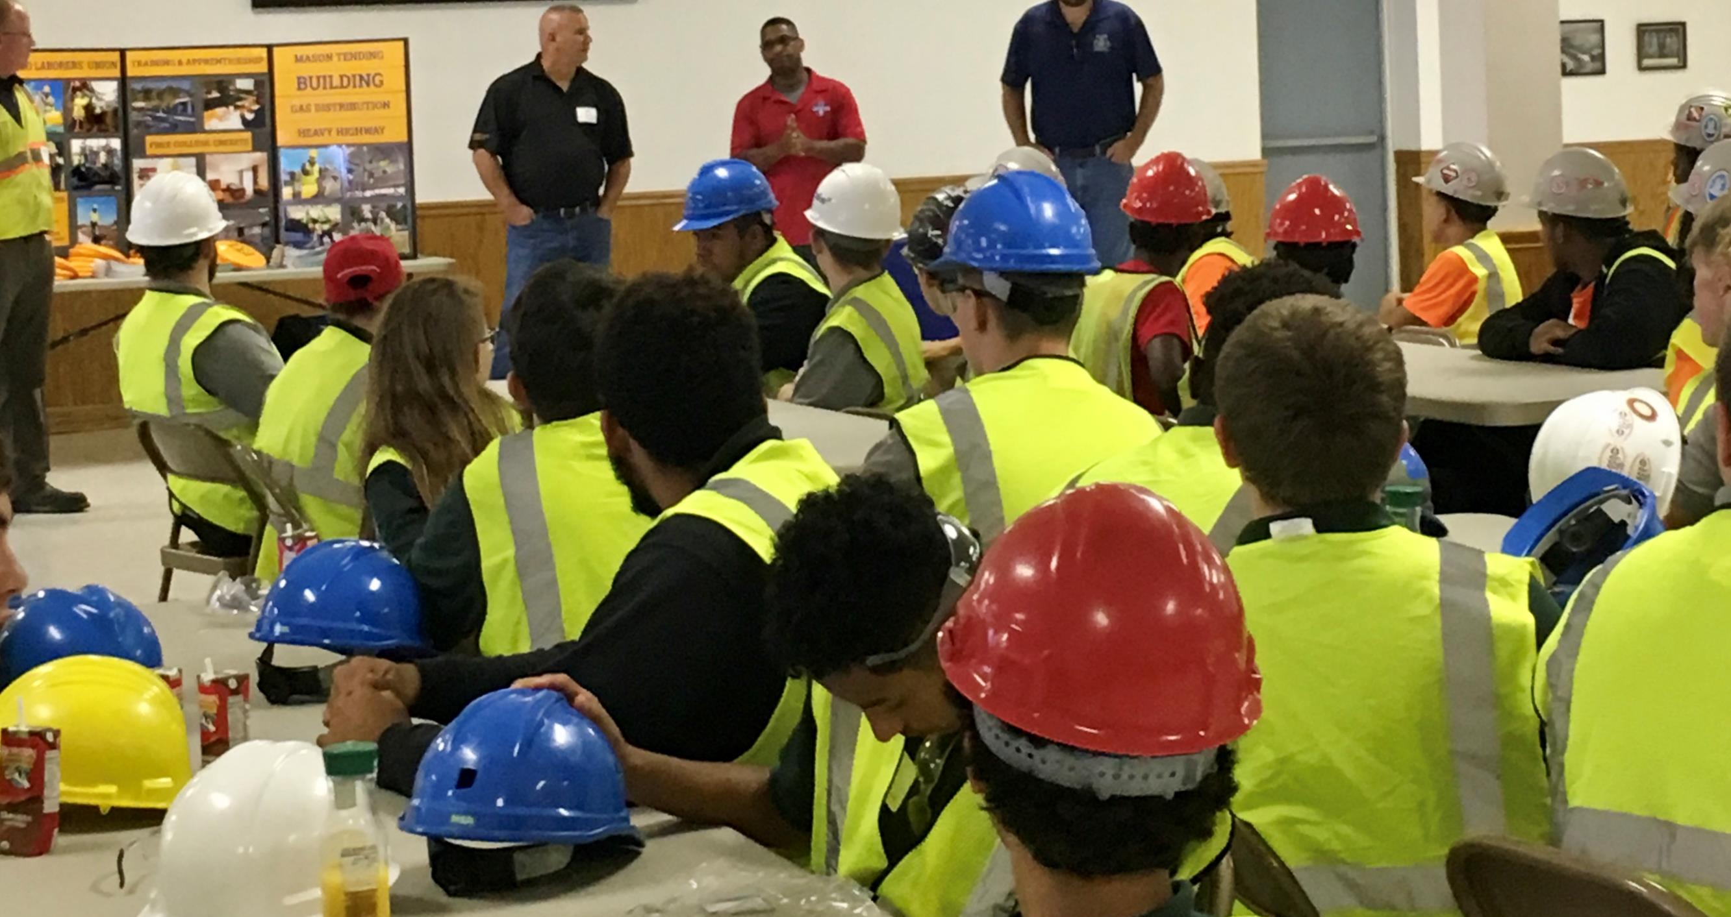
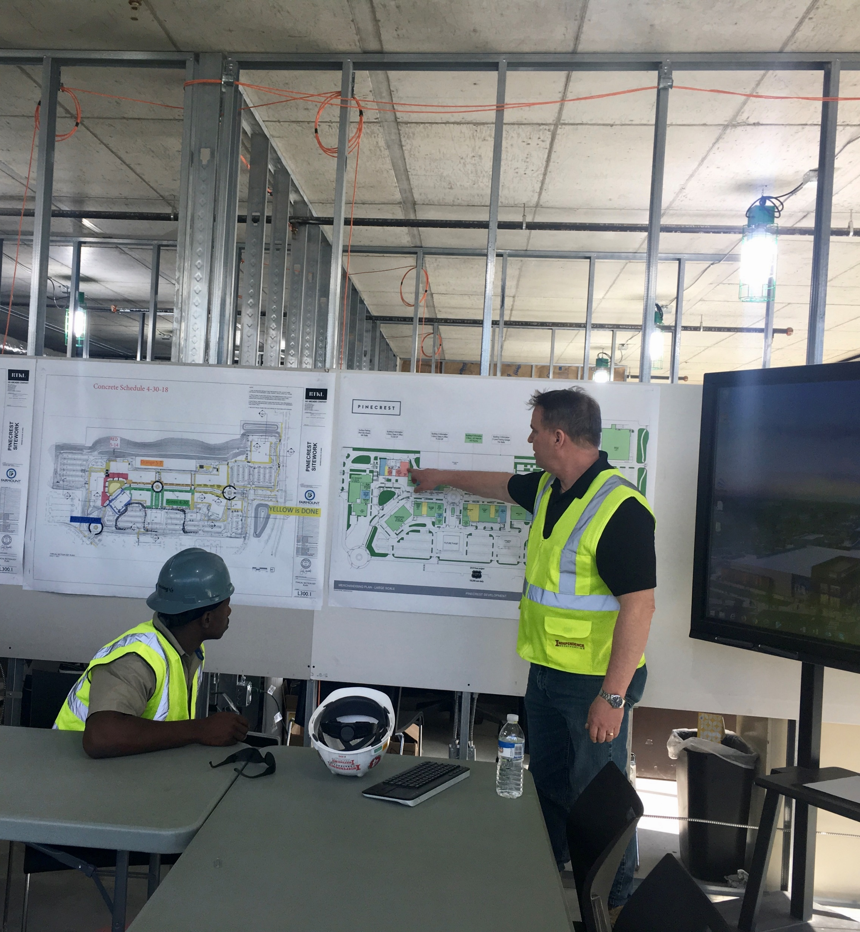
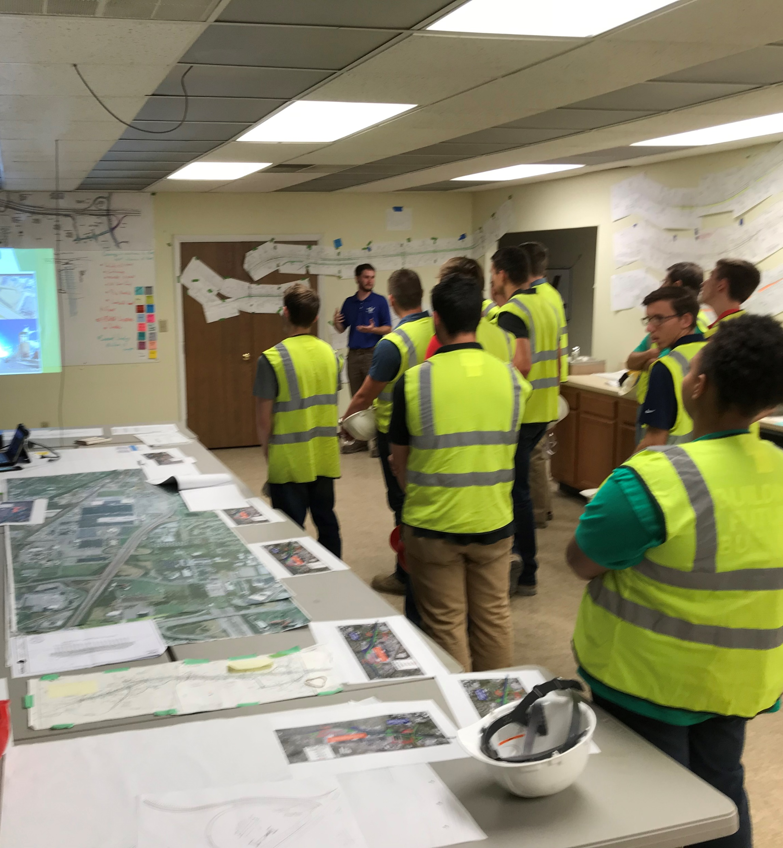
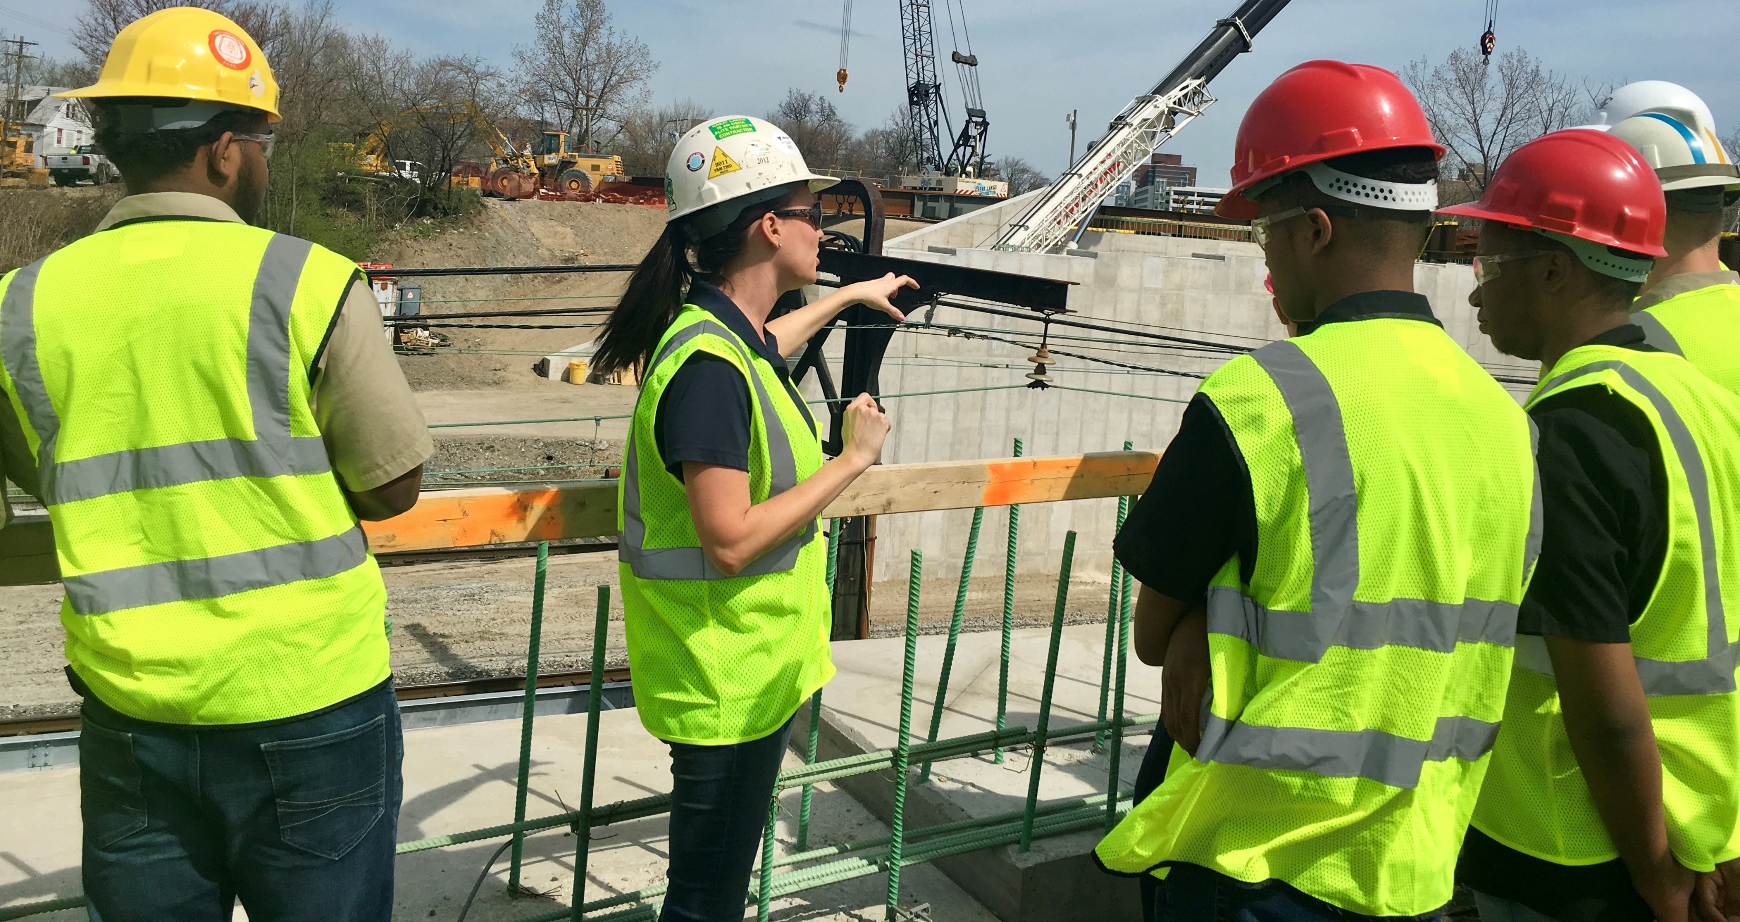
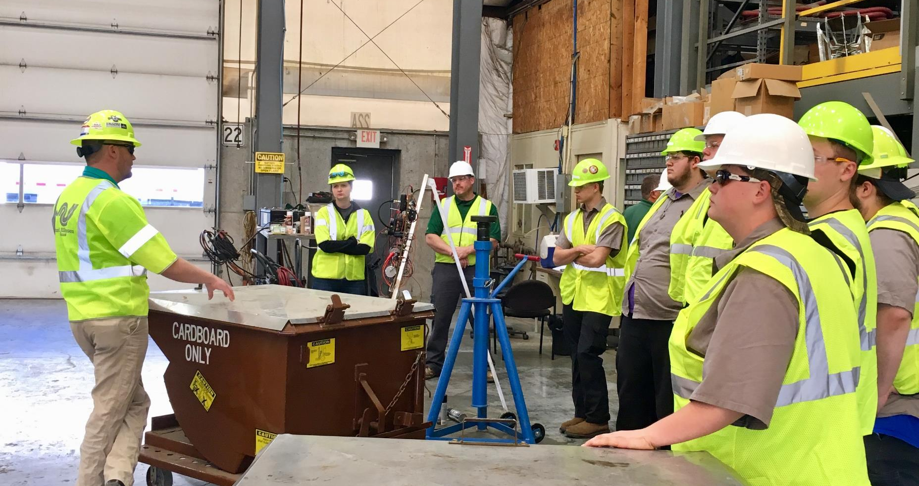
Connect with local contractors and visit construction jobsites

Slide 6
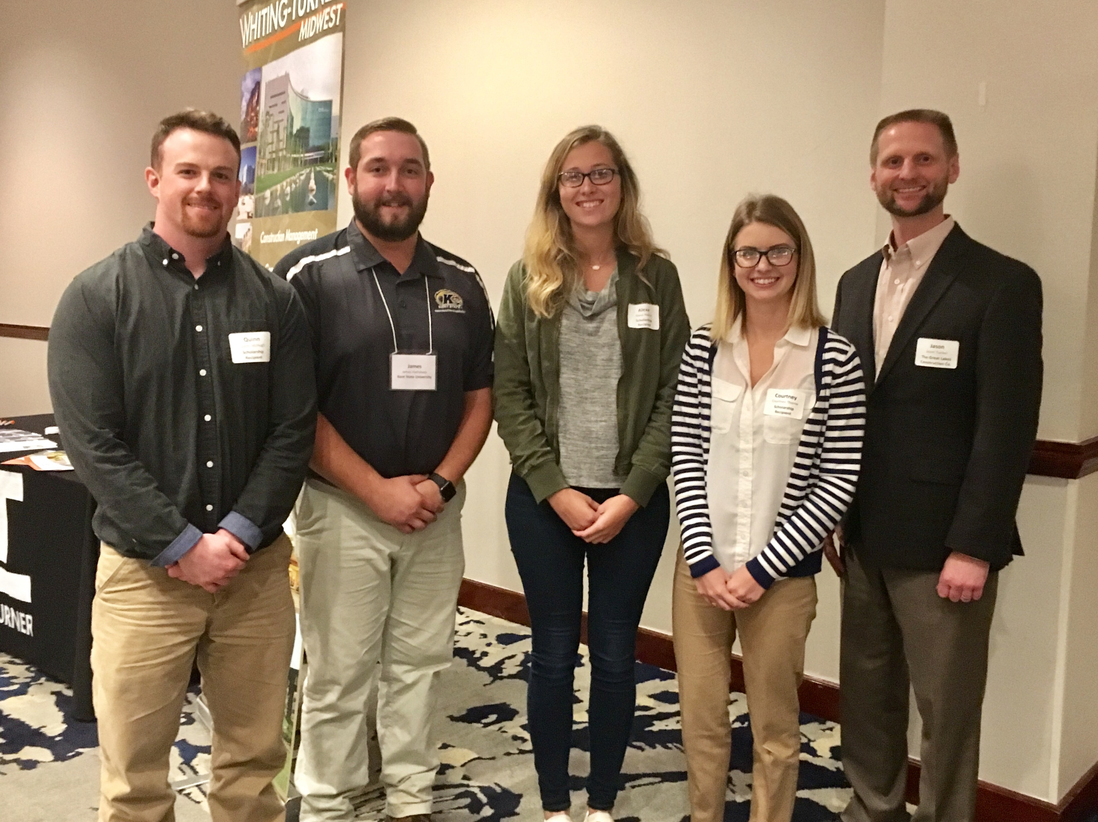
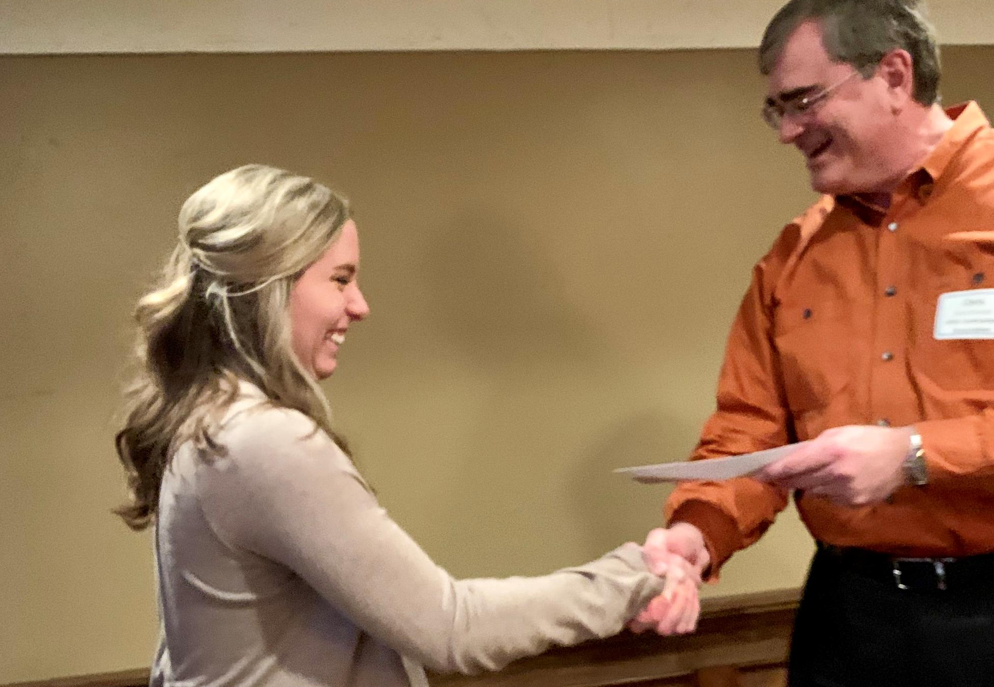
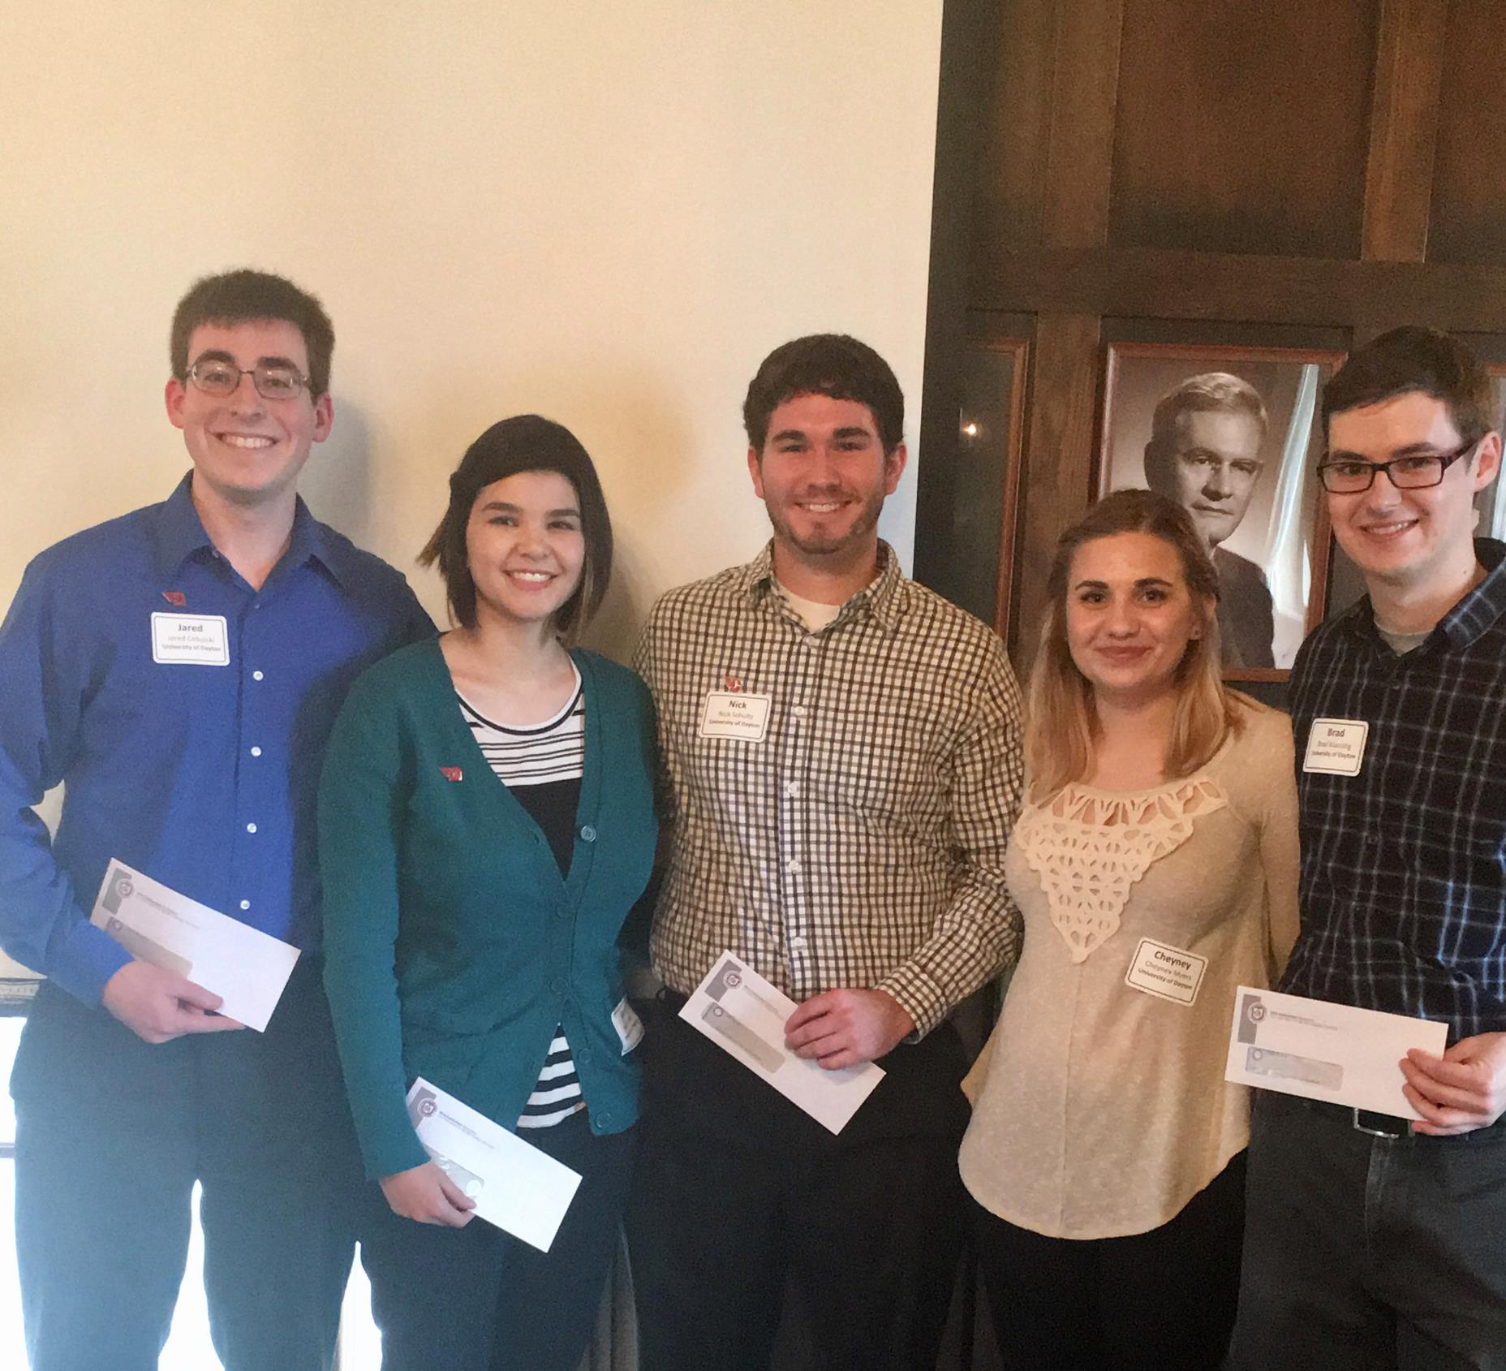
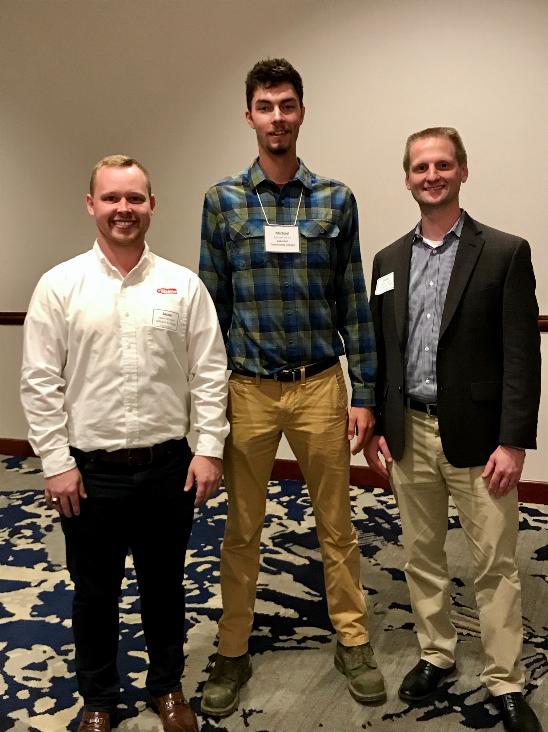
Scholarships for students pursuing two and four year construction-related degrees
In 2018, OCA presented
$59,750 to 36 students
around the state

Slide 7

Resources for Students,
Educators, Parents and Employers
I Build America - Ohio is a movement
to generate pride and respect for the
construction industry, and to recruit
young people into the Industry as a
rewarding and valuable career.

Slide 8


Slide 9

Website Resources
Career Descriptions with wages
Education Providers
  Apprenticeship Programs
  Career Tech Schools
  Two & Four Year Colleges
Downloadable Tool Boxes
for Educators and Employers
Videos

Slide 10

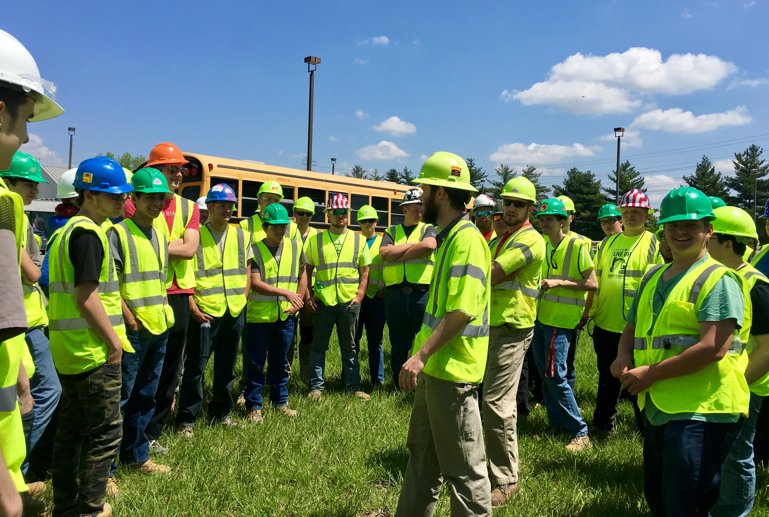

Job Experiences for
High School Students
Andy Fox
Kokosing Construction Company
Mike Obert and Damien Phillips
Complete General Construction

Slide 11
Contractor/Classroom Collaboration
Connecting educators with contractors to receive customized resources for classrooms
How can OCA members help?
Present career information to your class
Attend career fair
Provide material for a project
Help with job shadowing
Other ideas? Let us know!

Slide 12
Get Connected
Director of Chapter Development,
Melanie Kitchen
mkitchen@ohiocontractors.org
www.ohiocontractors.org
Home Page
Breaking News
Contractor/Classroom Collaboration educator contact form
https://form.jotform.com/90495566646168

